Slide 1
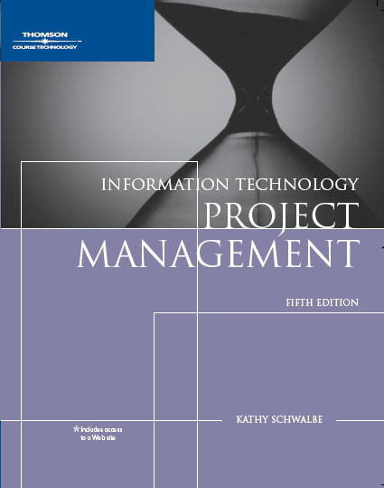
Chapter 2: The Project Management and Information Technology Context

Slide 2
Learning Objectives
Describe the systems view of project management and how it applies to information technology projects
Understand organizations, including the four frames, organizational structures, and organizational culture
Explain why stakeholder management and top management commitment are critical for a project’s success

Slide 3
Learning Objectives (continued)
Understand the concept of a project phase and the project life cycle and distinguish between project development and product development
Discuss the unique attributes and diverse nature of information technology projects

Slide 4
Projects Cannot Be Run in Isolation
Projects must operate in a broad organizational environment
Project managers need to use systems thinking
Taking a holistic view of carrying out projects within the context of the organization
Senior managers must make sure projects continue to support current business needs

Slide 5
A Systems View of Project Management
A systems approach emerged in the 1950s to describe a more analytical approach to management and problem solving
Three parts include:
Systems philosophy: an overall model for thinking about things as systems
Systems analysis: problem-solving approach
Systems management: address business, technological, and organizational issues before making changes to systems

Slide 6
System analysis
Defining the scope of the system,
Dividing it into components,
Identifying and evaluating its problems, opportunities, constraints, and needs.
Systems analyst:
examines alternative solutions for improving the current situation;
identifies an optimum, or at least satisfactory, solution or action plan;
And examines that plan against the entire system.

Slide 7
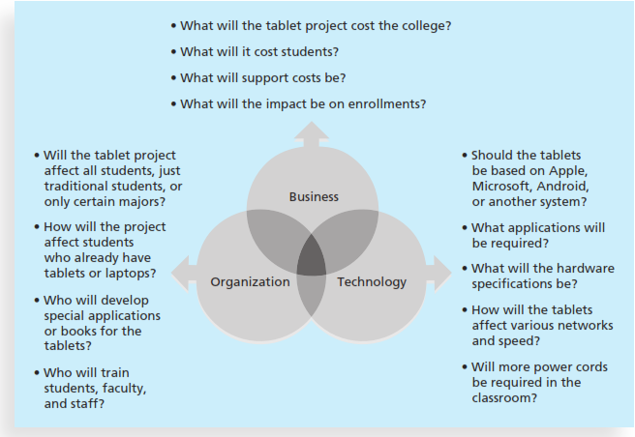
Three Sphere Model for Systems Management
7

Slide 8
Understanding Organizations
Structural frame: Focuses on roles and responsibilities, coordination and control. Organization charts help define this frame.
Human resources frame: Focuses on providing harmony between needs of the organization and needs of people.
Political frame: Assumes organizations are coalitions composed of varied individuals and interest groups. Conflict and power are key issues.
Symbolic frame: Focuses on symbols and meanings related to events. Culture, language,traditions, and image are all parts of this frame. Culture is important.

Slide 9
Organizational Structures
Three basic organization structures
Functional: functional managers report to the CEO
Project: program managers report to the CEO
Matrix: middle ground between functional and project structures; personnel often report to two or more bosses; structure can be weak, balanced, or strong matrix

Slide 10
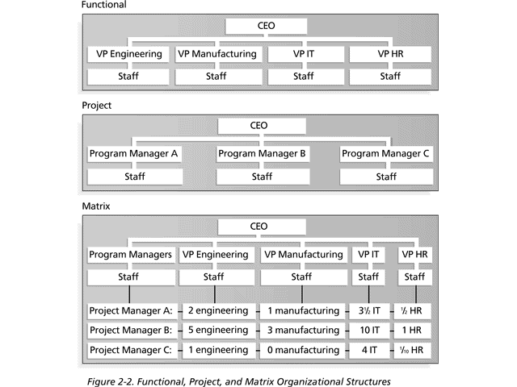
Functional, Project, and Matrix Organizational Structures
10

Slide 11
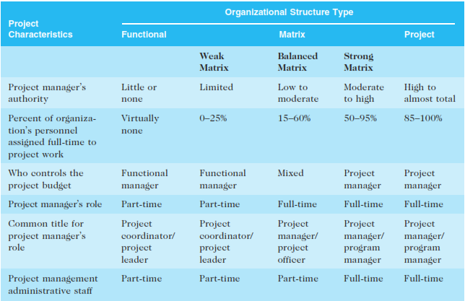
Organizational Structure Influences on Projects

Slide 12
Organizational Culture
Organizational culture is a set of shared assumptions, values, and behaviors that characterize the functioning of an organization
Many experts believe the underlying causes of many companies’ problems are not the structure or staff, but the culture

Slide 13
Ten Characteristics of Organizational Culture (Stephen P. Robbins and Timothy Judge, authors of a popular textbook on organizational behavior)
Member identity*
Group emphasis*
People focus
Unit integration*
Control
Risk tolerance*
Reward criteria*
Conflict tolerance*
Means-ends orientation
Open-systems focus*
*Project work is most successful in an organizational culture where these items are strong/high and other items are balanced
13

Slide 14
Ten Characteristics of Organizational Culture
Member identity: The degree to which employees identify with the organization as a whole rather than with their type of job or profession.
Group emphasis: The degree to which work activities are organized around groups or teams, rather than individuals.
People focus: The degree to which management’s decisions take into account the effect of outcomes on people within the organization.

Slide 15
Ten Characteristics of Organizational Culture
Unit integration: The degree to which units or departments within an organization are encouraged to coordinate with each other.
Control: The degree to which rules, policies, and direct supervision are used to oversee and control employee behavior.
Risk tolerance: The degree to which employees are encouraged to be aggressive, innovative, and risk seeking.
Reward criteria: The degree to which rewards are allocated according to employee performance rather than seniority, favoritism, or other nonperformance factors.

Slide 16
Ten Characteristics of Organizational Culture
Conflict tolerance: The degree to which employees are encouraged to air conflicts and criticism openly.
Means-ends orientation: The degree to which management focuses on outcomes rather than on techniques and processes used to achieve results.
Open-systems focus: The degree to which the organization monitors and responds to changes in the external environment.

Slide 17
Stakeholder Management
Project managers must take time to identify, understand, and manage relationships with all project stakeholders
Using the four frames of organizations can help meet stakeholder needs and expectations
Senior executives/top management are very important stakeholders

Slide 18
Best Practice
IT governance addresses the authority and control for key IT activities in organizations, including IT infrastructure, IT use, and project management
A lack of IT governance can be dangerous, as evidenced by three well-publicized IT project failures in Australia (Sydney Water’s customer relationship management system, the Royal Melbourne Institute of Technology’s academic management system, and One.Tel’s billing system)

Slide 19
The Importance of Top Management Commitment
Project managers need adequate resources.
Project managers often require approval for unique project needs in a timely manner.
Project managers must have cooperation from people in other parts of the organization.
Project managers often need someone to mentor and coach them on leadership issues.

Slide 20
Need for Organizational Commitment to Information Technology (IT)
If the organization has a negative attitude toward IT, it will be difficult for an IT project to succeed
Having a Chief Information Officer (CIO) at a high level in the organization helps IT projects
Assigning non-IT people to IT projects also encourages more commitment

Slide 21
Need for Organizational Standards/ Guidelines
Standards and guidelines help project managers be more effective
Senior management can encourage:
The use of standard forms and software for project management
The development and use of guidelines for writing project plans or providing status information
The creation of a project management office or center of excellence

Slide 22
Project Phases and the Project Life Cycle
A project life cycle is a collection of project phases that defines:
What work will be performed in each phase
What deliverables will be produced and when
Who is involved in each phase
How management will control and approve work produced in each phase
A deliverable is a product or service produced or provided as part of a project
initiating, planning, executing, monitoring and controlling, and closing

Slide 23
More on Project Phases
In early phases of a project life cycle:
Resource needs are usually lowest
The level of uncertainty (risk) is highest
Project stakeholders have the greatest opportunity to influence the project
In middle phases of a project life cycle:
The certainty of completing a project improves
More resources are needed
The final phase of a project life cycle focuses on:
Ensuring that project requirements were met
The sponsor approves completion of the project

Slide 24
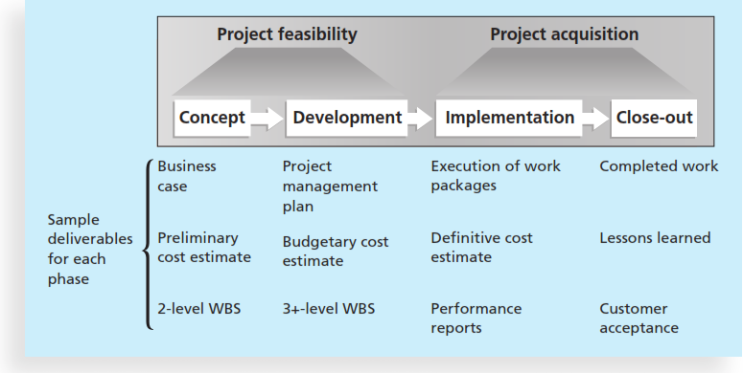
Phases of the Traditional Project Life Cycle
24

Slide 25
Product Life Cycles
Products also have life cycles
The Systems Development Life Cycle (SDLC) is a framework for describing the phases involved in developing and maintaining information systems
Systems development projects can follow:
Predictive life cycle: the scope of the project can be clearly articulated and the schedule and cost can be predicted
Adaptive Software Development (ASD) life cycle: requirements cannot be clearly expressed, projects are mission driven and component based, using time-based cycles to meet target dates

Slide 26
Predictive Life Cycle Models
Waterfall model: has well-defined, linear stages of systems development and support
Spiral model: shows that software is developed using an iterative or spiral approach rather than a linear approach
Incremental build model: provides for progressive development of operational software
Prototyping model: used for developing prototypes to clarify user requirements
Rapid Application Development (RAD) model: used to produce systems quickly without sacrificing quality

Slide 27
The Importance of Project Phases and Management Reviews
A project should successfully pass through each of the project phases in order to continue on to the next
Management reviews, also called phase exits or kill points, should occur after each phase to evaluate the project’s progress, likely success, and continued compatibility with organizational goals

Slide 28
The Context of IT Projects
IT projects can be very diverse in terms of size, complexity, products produced, application area, and resource requirements
IT project team members often have diverse backgrounds and skill sets
IT projects use diverse technologies that change rapidly; even within one technology area, people must be highly specialized

Slide 29
RECENT TRENDS AFFECTING INFORMATION TECHNOLOGY PROJECT MANAGEMENT
Globalization – everyone is connected
Outsourcing and offshoring
Virtual teams

Slide 30
Chapter Summary
Project managers need to take a systems approach when working on projects
Organizations have four different frames: structural, human resources, political, and symbolic
The structure and culture of an organization have strong implications for project managers
Projects should successfully pass through each phase of the project life cycle
Project managers need to consider several factors due to the unique context of information technology projects

